Slide 1
Uber New York Data Analysis
Submitted by: Anshi singh

Slide 2
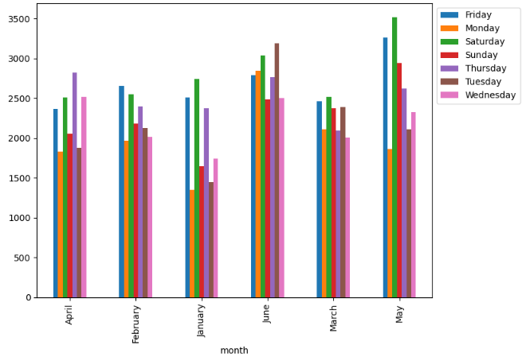
Analysis
This is a grouped bar chart showcasing in every month these are the Uber pickups for each of the weekday in NY city.
As we can see, June has the highest number of Uber pickups.
Starting from Thursday to Saturday, the Uber pickups is high for these days in each month.

Slide 3
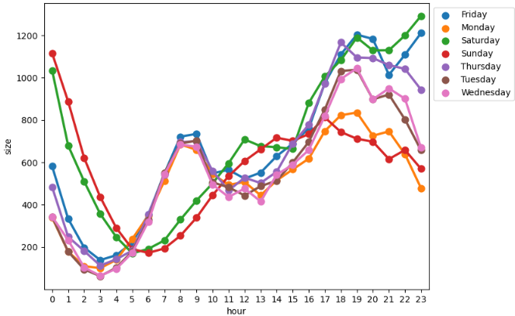
Analysis
The chart shows Hourly rush on all days in NY city.
We can see Saturday and Sunday are following the same trend till afternoon but in evening it shows the opposite trend since Saturday pickups continue to increase throughout evening but Sunday pickups take a downward turn after evening
Thursday night also has a similar trend in comparison to Friday and Saturday. This shows that New Yorkers start their weekend from Thursday night.

Slide 4
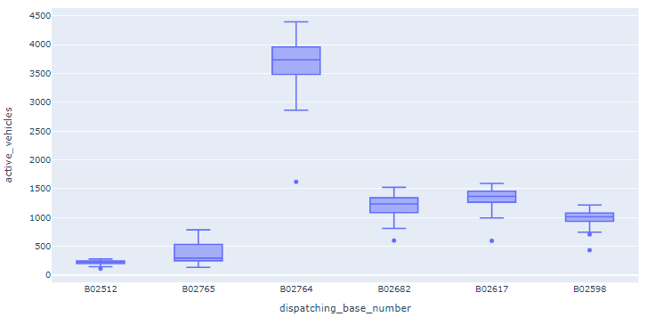
Analysis
The chart shows Base number having Active number of Vehicles.
It shows the distribution of the base numbers with respect to the active vehicles.
The base number B02764 has the most number of active vehicles.

Slide 5
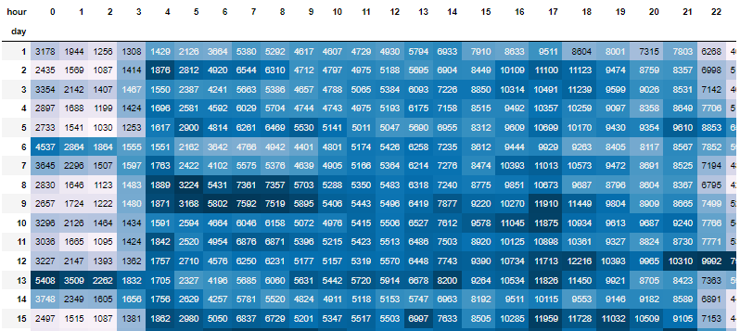
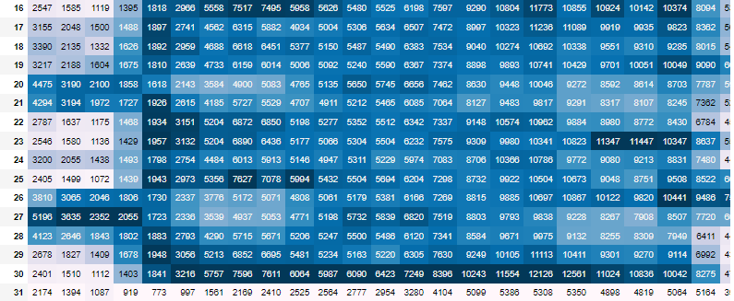
Analysis
This chart shows the rush on Hour & Weekday.
Darker the color of the cell like on day 9th, we can say there is rush early morning in NY city.

Slide 6
Thank You!!

